Slide 1
End-to-end System for Physiotherapy Rehabilitation Data Monitoring
Adil Bin Azmoon
CG4001 B. Eng Dissertation 2019/2020

Slide 2
Motivations
Physiotherapy relies heavily on consistent treatment sessions
set physiotherapy schedule
encourage exercises to be continued at home
This current system hinges on the discipline of the patients in adhering to the schedule.
Highly common for patients to miss sessions.
Impossible for physiotherapists to ensure that their patients are carrying out the prescribed exercises at home.

Slide 3
Overview
The system integrates existing commercial hardware, such as the Microsoft Kinect, for ease of access.
The software development of the proposed system can be split into two main portions:
The machine learning model that are required to accurately classify patients’ progress.
The end-to end full stack web application that will be accessed by both patients and physiotherapists.
Furthermore, the system focuses on shoulder injuries and range of motion exercises for the scope of this project.

Slide 4
Literature Review
 | Sensors | Type of experiment | Targeted disease | Targeted therapy | Body parts involved
Attiya Baqai et al. (Baqai et al 2018) | Kinect for Windows Oculus Rift Arduino e-Health sensor shield v2.0 (pulse, respiration, GSR, temperature) | Intra-subject | Parkinson’s disease | Physical | Head Neck Upper limbs Lower limbs Back Step size
Zelai Saenz de Urturi Breton et al. (de Urturi Breton et al. 2012) | Kinect for Windows | Intra-subject | Dementia | Mental | Upper limbs
David Gonzalez-Ortega et al. (Gonzalez-Ortega et al. 2014) | Kinect for Windows | Intra-subject | Dementia | Mental | Upper limbs Head
Alejandro Baldominos et al. (Baldominos et al. 2015) | Oculus Rift DK2 Intel RealSense | Intra-subject | - | Physical | Shoulder abduction and adduction
Inigo de Loyola Ortiz-Vigon Uriarte et al. (Uriarte et al. 2015) | Tobii Eye Tracker Kinect for Windows Zephyr BioHarness 3 Arduino e-Health sensor shield v2.0 (EMG, GSR) | Intra-subject | - | Physical | Eyes Upper limbs

Slide 5
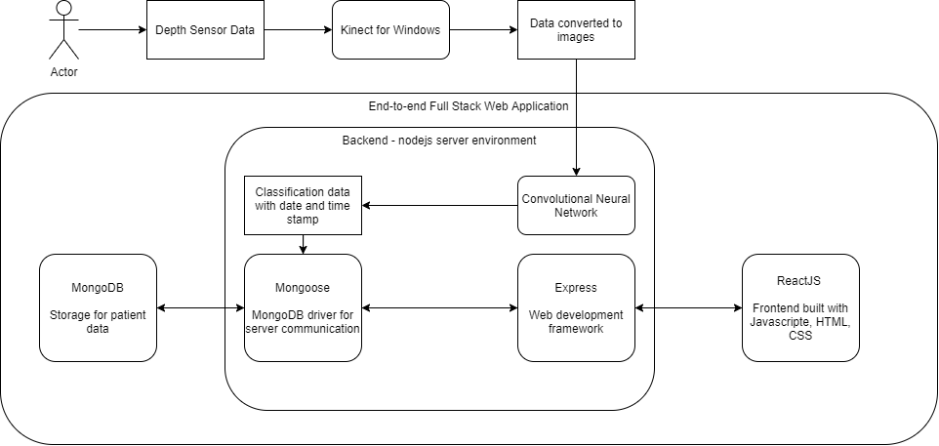
Project Overview
Monitoring system with full-stack implementation + machine learning model

Slide 6
Hardware – Kinect Sensor
Depth images are obtained using Matlab’s Image Acquisition Toolbox
Image quantity can be adjusted via Matlab script
Images are exported in PNG, ideal for use in CNN at the next stage

Slide 7
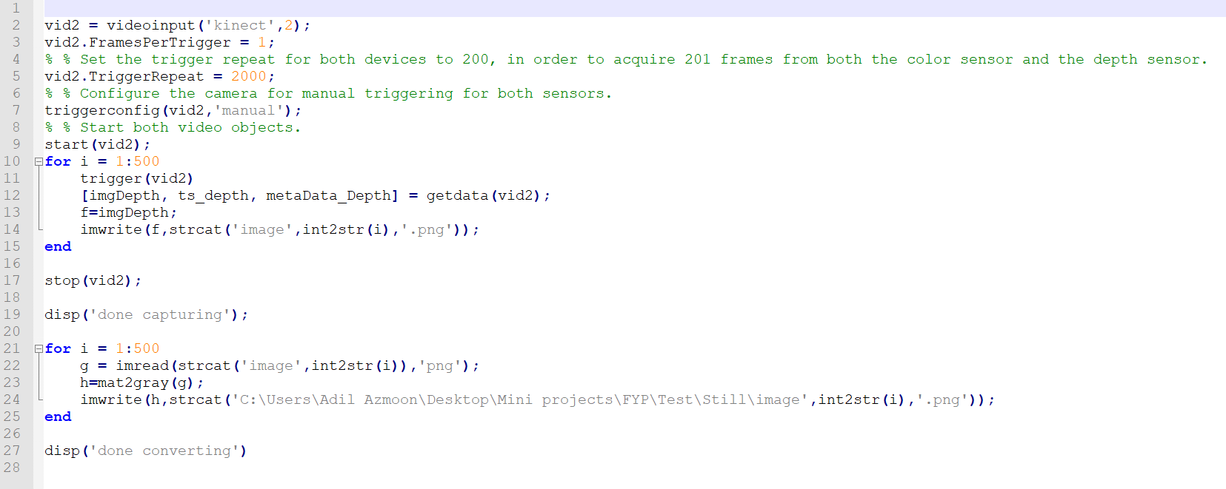
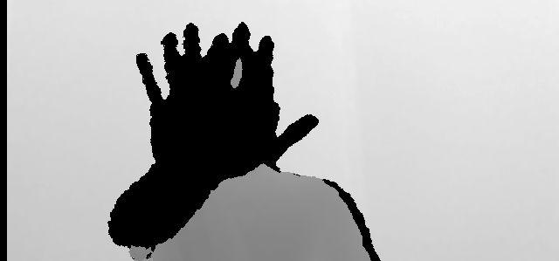
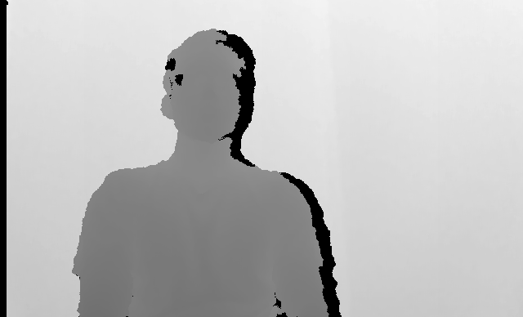
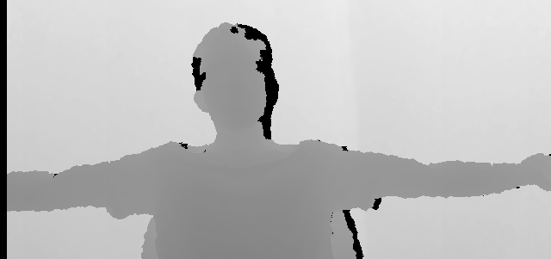
Hardware – Kinect Sensor

Slide 8
Machine Learning Model
The software will incorporate machine learning:
Convolutional Neural Network is used in processing the patients’ current progress in rehabilitation. CNN is chosen as it is a highly popular model for image classification in machine learning.
This is written, trained and validated in Python utilizing existing Tensorflow and keras libraries.
Converted to Tensorflow Layers Model for deployment on the full stack web application.

Slide 9
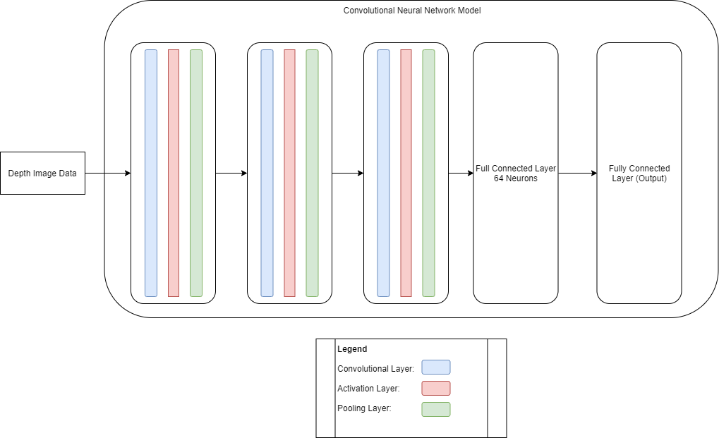
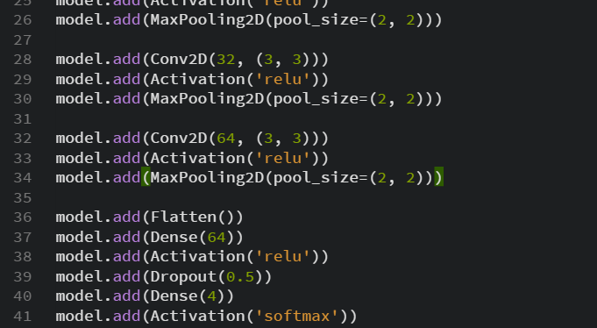
Convolutional Neural Network
Built in Python using Tensorflow library
3 convolutional layers, 3 max pooling layers 2 fully connected layers
Notes:
The rectified linear activation function is a piecewise linear function that will output the input directly if is positive, otherwise, it will output zero. It has become the default activation function for many types of neural networks because a model that uses it is easier to train and often achieves better performance.
The sigmoid and hyperbolic tangent activation functions cannot be used in networks with many layers due to the vanishing gradient problem.
The rectified linear activation function overcomes the vanishing gradient problem, allowing models to learn faster and perform better.
The rectified linear activation is the default activation when developing multilayer Perceptron and convolutional neural networks.

Slide 10
Software
3 tier web architecture
Database
MongoDB
Back End Server
Node.js server environment
Front End Client
ReactJS

Slide 11
Database – MongoDB
Schema
does not enforce document structure by default
allows flexibility and modularity in modelling the data acquired

Slide 12
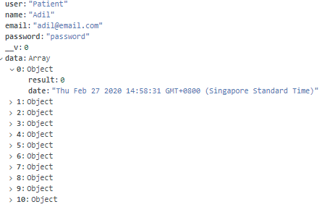
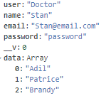
Schema examples

Slide 13
Back End - Server
Designed to receive requests from the front-end client, process said requests by accessing the database and returning pertinent data.
Data processing is done on the server to ensure security of user data.
CNN machine learning model is also hosted and served directly from the server directory.

Slide 14
Package dependencies
Dependency | Description
express | Web framework for node.js
body-parser | Parses incoming request bodies
concurrently | Runs multiple node commands for development troubleshooting
cors | Provides middleware to enable Cross Origin Resource Sharing
mongoose | MongoDB object modeling tool
morgan | HTTP request logger middleware
nodemon | Development tool that automatically restarts node.js environment when changes to file in the directory are detected.

Slide 15
Front End - Client
Designed for ease of use, as the system is intended for commercial use.
2 main roles
Data submission
Data visualisation

Slide 16
Package dependencies
Dependency | Description
tfjs | Tensorflow library to serve compiled machine learning models.
axios | Promise based HTTP client for browsers and node.js. Handles HTTP requests from and to client.
bootstrap | Powerful front-end framework for web development.
canvasjs | Charts library for data visualization.
jquery | Feature-rich Javascript library. Necessary for Bootstrap framework.
react | Library for front-end web interface development.
react-router-dom | Library for React Router navigational components.

Slide 17
Client – Data submission
Patients can submit data in the form of depth images in PNG format through the front-end client.
On loading, CNN model is automatically requested and served on the client.
Users upload the image, feed it into the model and receive the appropriate classification for the image.
This classification data can then be submitted to the back end which then stores it in the database in the appropriate schema.

Slide 18
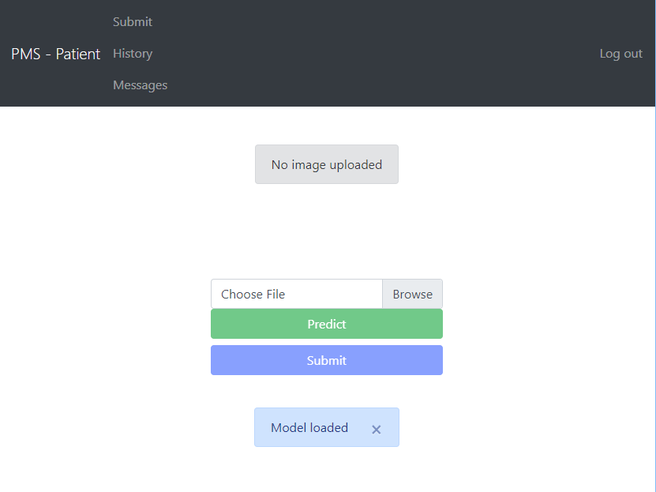

Slide 19
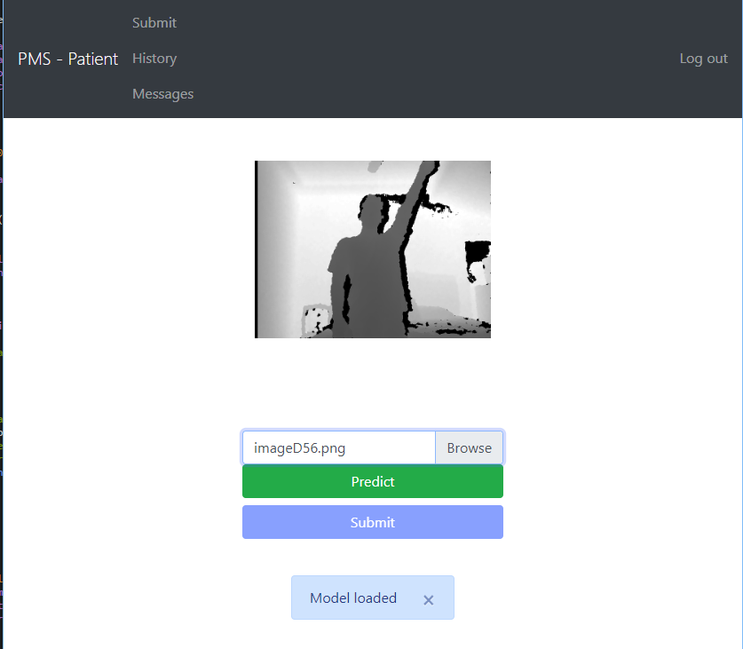

Slide 20
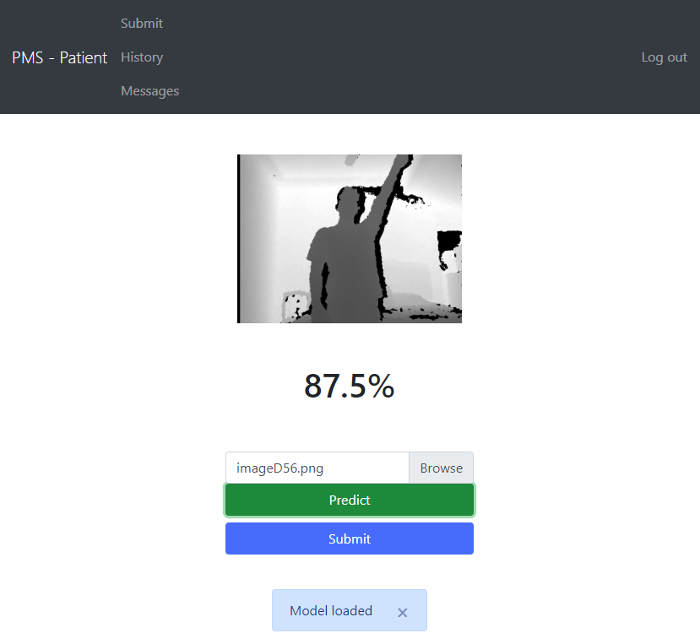

Slide 21
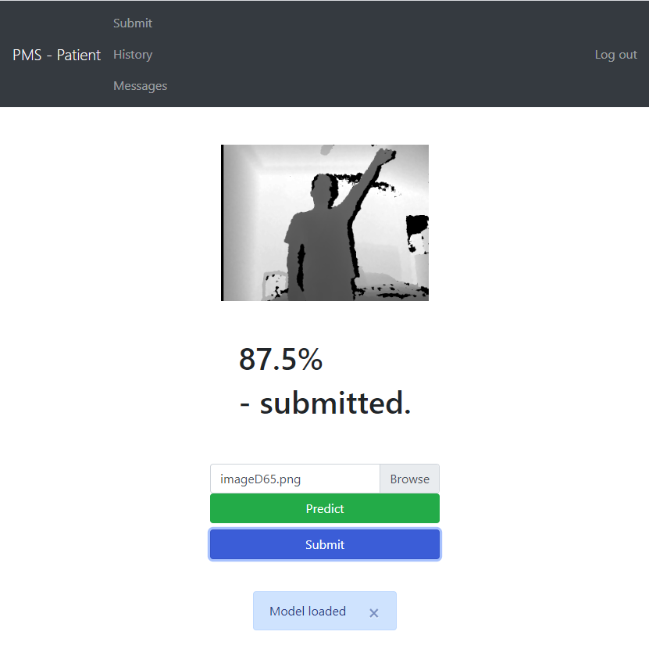

Slide 22
Client – Data visualization
Patients can access and visualise their history of submitted data in the form of line graphs.
Best fit line is also displayed to provide users a rough indication of their recovery progress.
Physiotherapists can access the data visualisation of all their patients in a similar fashion.

Slide 23
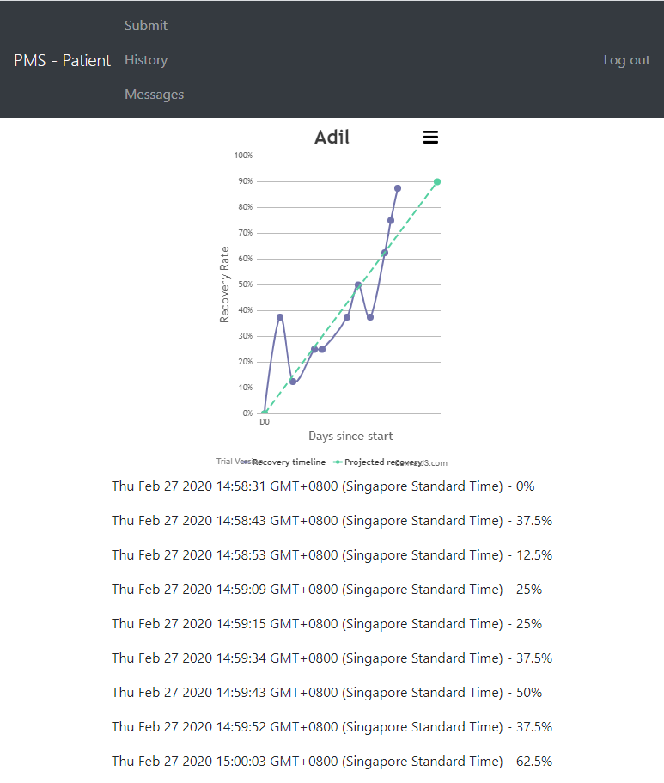

Slide 24
Results and analysis
Accessibility
Availability
Cost
Efficiency
Time taken to capture, submit data and leave system
Effectiveness
Viability in various differing fields of physiotherapy

Slide 25
 | Hardware Sensors | Accessibility | Efficiency | Effectiveness
Proposed and implemented system | Kinect for Windows | The implemented full stack web application is accessible by most devices with updated browser applications and the Kinect for Windows is also a relatively inexpensive and commercially available product, making this implementation largely accessible. | Current implementation of image capture is slightly inefficient, requiring third party software, and basic understanding of scripts. Data submission and visualization is kept extremely simple on the web application, allowing efficient use by patients. | The system is limited to only physiotherapy regimes that can see marked improvements through physical improvements in large muscle groups (i.e. limb mobility), due to the hardware limitations.
Attiya Baqai et al. (Baqai et al 2018) | Kinect for Windows Oculus Rift Arduino e-Health sensor shield v2.0 (pulse, respiration, GSR, temperature) | The Oculus Rift and e-Heath sensors are high-cost equipment that may be largely inaccessible to patients of lower socio-economic status. | The use of the e-Health sensors can be extremely inefficient as they require an intermediate level of understanding of the equipment and software, and also requires a significant amount of time (>15 mins) to acquire data. | This implementation can find a use in and can be highly effective in a large majority of physiotherapy regimes due to the comprehensiveness of the equipment employed.

Slide 26
 | Hardware Sensors | Accessibility | Efficiency | Effectiveness
Alejandro Baldominos et al. (Baldominos et al. 2015) | Oculus Rift DK2 Intel RealSense | The Oculus Rift is a high-cost equipment that may be largely inaccessible to patients of lower socio-economic status. | Both the Oculus Rift and Intel RealSense can be operated by patient users as they are designed for commercial use. Depending on patient users’ own technological understanding, this system can be efficient but would still require a significantamount of time for data acquisition | This implementation can find a use in and can be highly effective in a large majority of physiotherapy regimes due to the comprehensiveness of the equipment employed.
Inigo de Loyola Ortiz-Vigon Uriarte et al. (Uriarte et al. 2015) | Tobii Eye Tracker Kinect for Windows Zephyr BioHarness 3 Arduino e-Health sensor shield v2.0 (EMG, GSR) | - The Oculus Rift, Zephyr BioHarness 3 and e-Heath sensors are high-cost equipment that may be largely inaccessible to patients of lower socio-economic status. | The use of the e-Health sensors and Zephyr BioHarness can be extremely inefficient as they require an intermediate level of understanding of the equipment and software, and also requires a significant amount of time (>15 mins) to acquire data. | This implementation can find a use in and can be highly effective in a large majority of physiotherapy regimes due to the comprehensiveness of the equipment employed.

Slide 27
Conclusion
This end-to-end physiotherapy data monitoring was designed to minimise patients’ pain points and inconveniences.
Allowing remote submission of progress
This would, in turn, encourage said patients follow their physiotherapy regimes, at home where applicable, more closely and consistently.

Slide 28
Improvements
Current implementation covers basic functionalities of login, submission and visualization.
Upgraded system with beneficial features would be ideal.
Message system
Comprehensive data editing portal for doctors
Addition of CNN models for different body parts for different physiotherapy regimes.

Slide 29
Improvements (contd.)
Current data capturing solution is far from ideal
Use of 3rd party software (Matlab)
Use of updated depth and motion capturing tools can benefit the system greatly
i.e. Azure Kinect 2019, Intel Realsense
Update SDKs and package dependencies available for node.js
Integration of data capturing directly on the portal itself

